Slide 1
(Advanced?) Git
Paddy O'Toole

Slide 2
Topics
Introduction to git
How we collaborate on bigger projects using pull requests, and reviews
Maintaining a "clean" git
Reverting and not ruining everything

Slide 3
Who is using git?

Slide 4
Who uses git on the command line?

Slide 5
What is git?
Git manages the evolution of a set of files in a structured way
Stores metadata and history
Who: The name of the person making changes
When: Date and time change
What: contents of files changed
Why: motivation for the change
Plus tools for working with the metadata

Slide 6
Why not just use Dropbox/Sharepoint?
Initial learning curve can be quite steep so why all the effort?
Collaboration! Git allows you to work independently, then share your own work or integrate work from others at time of your choosing
Does dropbox have a history?

Slide 7
Terminology
Repository – git's database which might be local or on GitHub
Working copy – the files you actually work with
Hash – a fingerprint of a file or a repository
Commit – a snapshot of all the files in the repo, and the act of creating a snapshot. A commit is just a tag on a hash

Slide 8
Git and GitHub
Git is not GitHub, git is the version control system, github is a hosting service for git repositories
GitLab is an open source GitHub alternative
GitHub adds helpful tooling including
Issues
Pull request
Organisations
Hosting webpages on gh-pages

Slide 9
Things to note
Git doesn't store diffs
It stores snapshots of the files you work with but is very space efficient
If you put something into git you can probably get it out again later (see git reflog)

Slide 10
Command line or GUI?
GUIs are great but you will have to use command line for some of the more complex topics later on. But they should be sufficient for 95% of what you do day to day
GitHub desktop is good
RStudio has a built in one
Other IDEs have built in git

Slide 11
Commit messages
One set of related changes
Commit message explains why they were needed
Short title (<60 character)
Blank line, then any further discussion
I usually try to complete the sentence "When applied this commit will …" (imperative case!)

Slide 12

Solo Workflow
Create a new repo
Work on main always
Make changes
Commit them
Push them

Slide 13
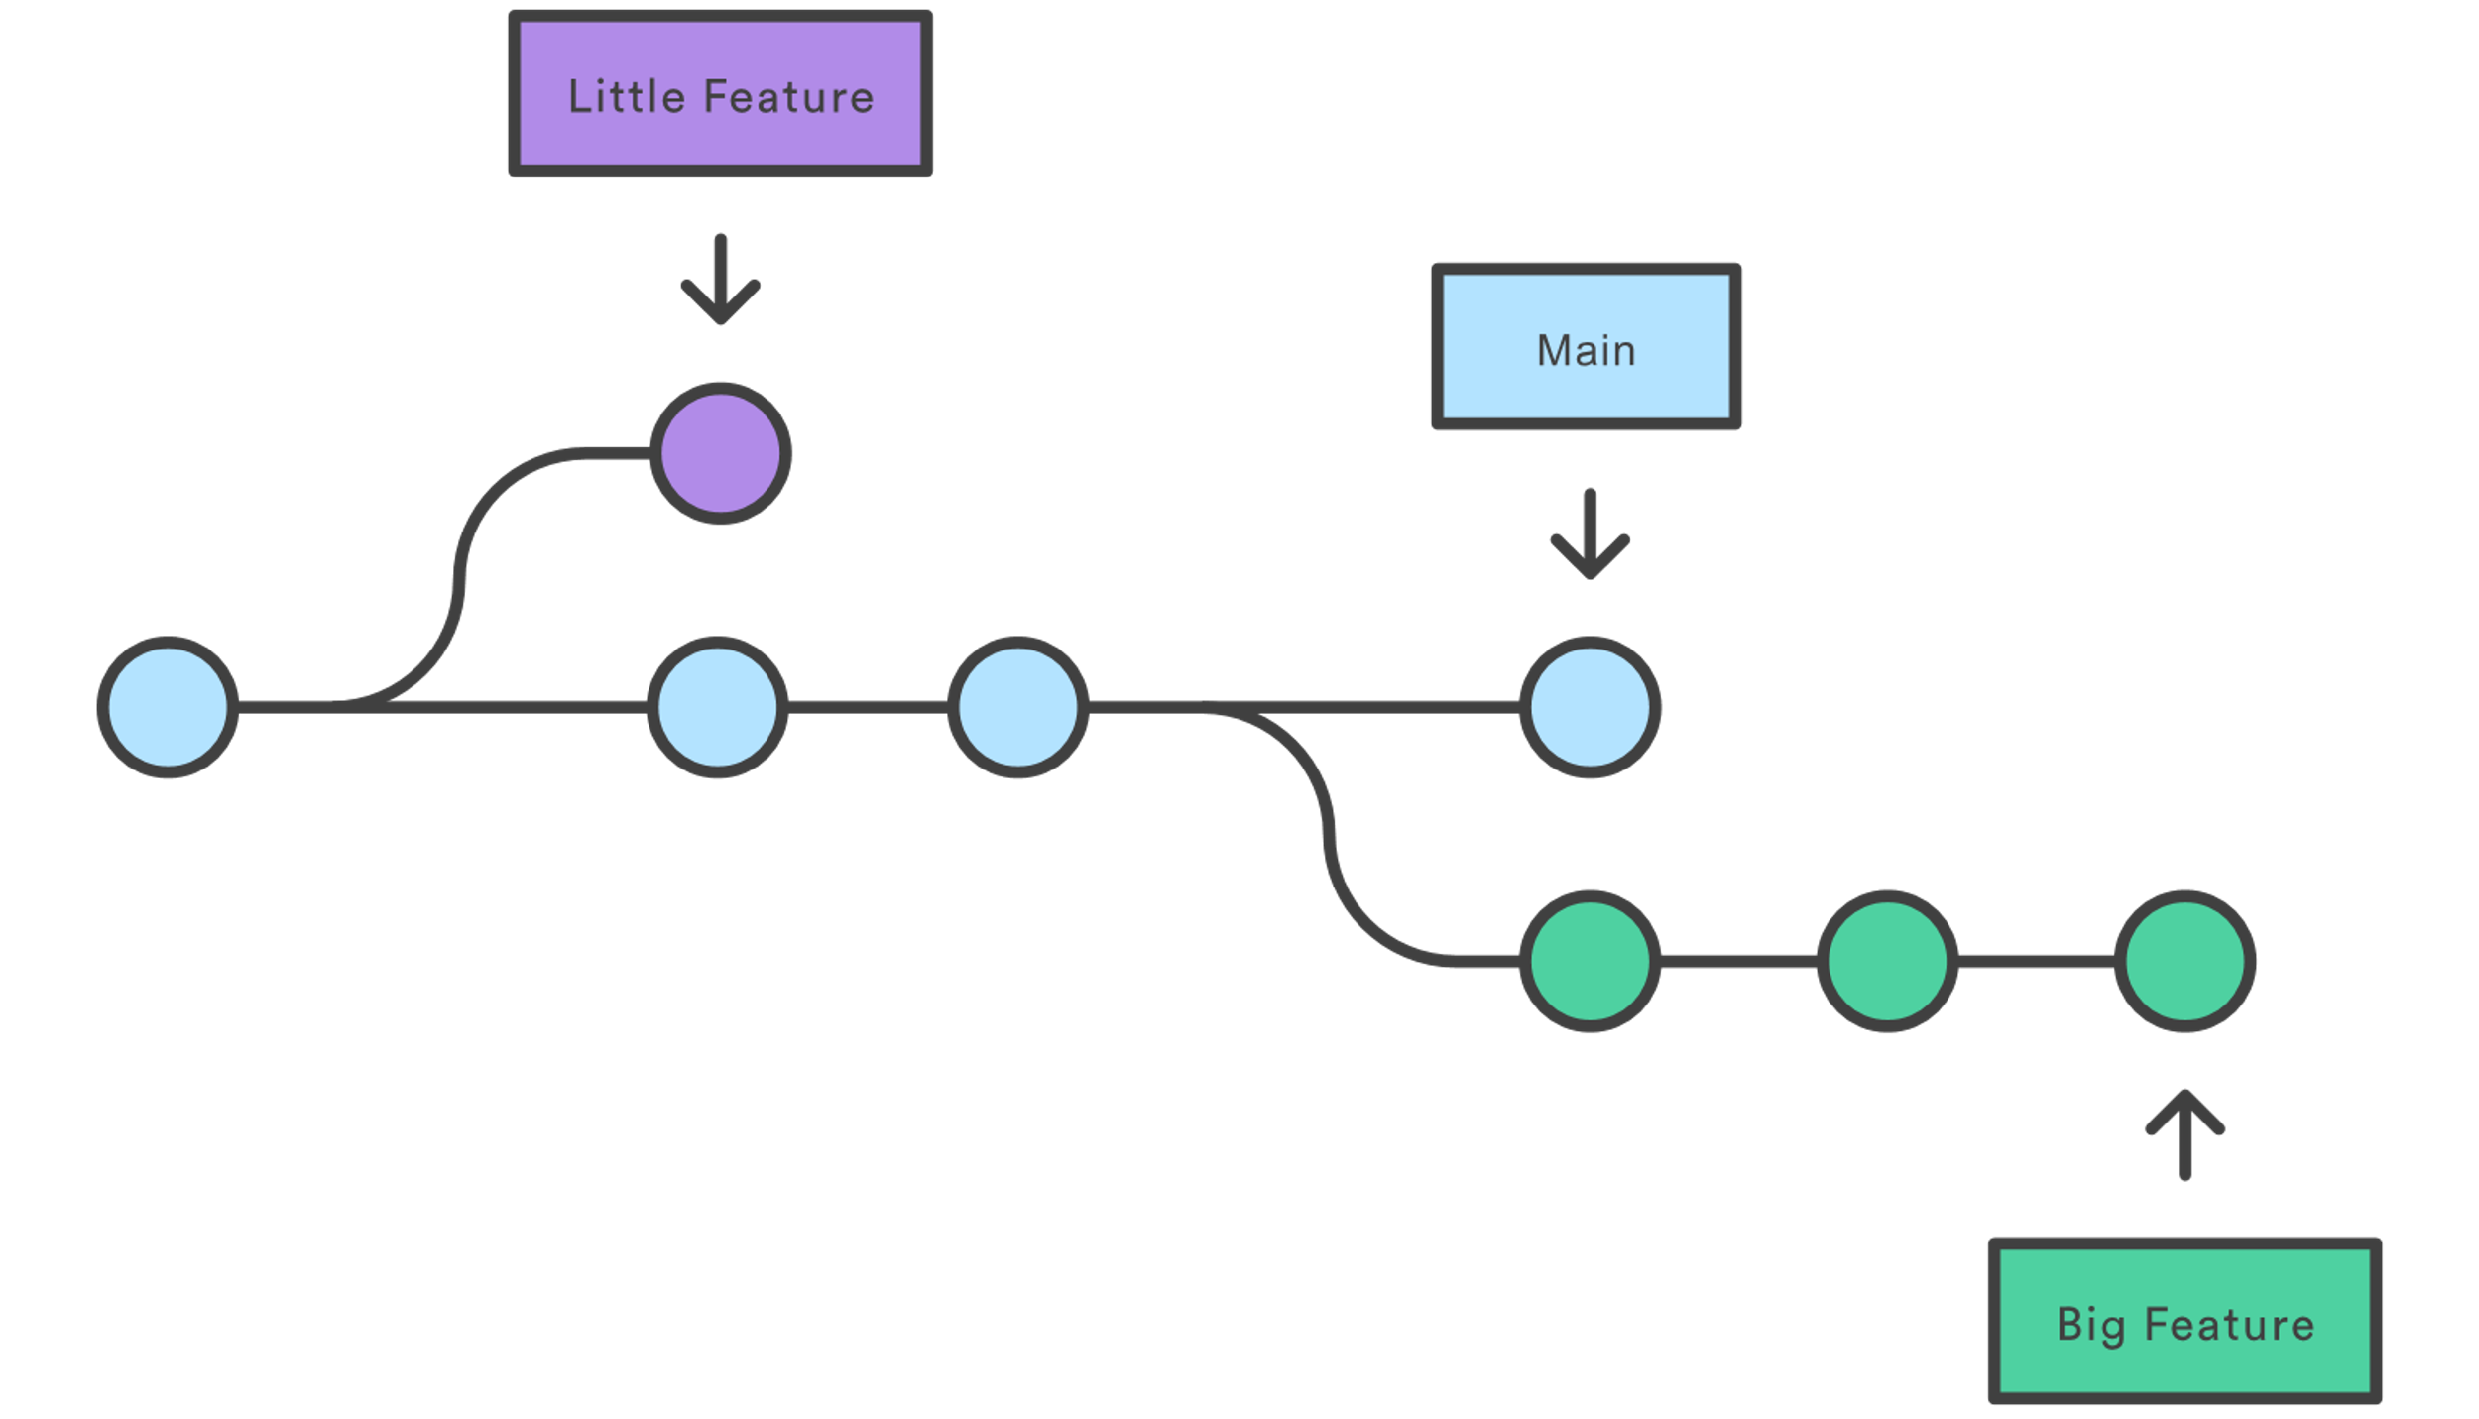
Branches
For collaborative workflows you will want to use branches

Slide 14
Collaborative workflow
Create a new repo
Create a branch from main
Make changes
Commit them to a branch
Push to remote
Create a pull request
Get a review from a collaborator
Make any requested changes
Merge into main
Main
feature

Slide 15
Collaborative workflow
Pair up
Give me at least one of your github usernames to add as collaborator
Clone demo repo https://github.com/potoole7/git-workflow-demo
Try the collaborative workflow
Create a branch from main
Make changes
Commit them to a branch
Push to remote
Create a pull request
Get a review from the person next to you
Make any requested changes
Merge into main

Slide 16
Collaborative workflow – forking
If you want to make changes to a repo you don't have access to, you'll have to fork it
Fork is a copy of a repo into your (or some other) namespace
You can create a pull request into their repo from yours
https://github.com/ropensci/geojsonio/pull/177

Slide 17
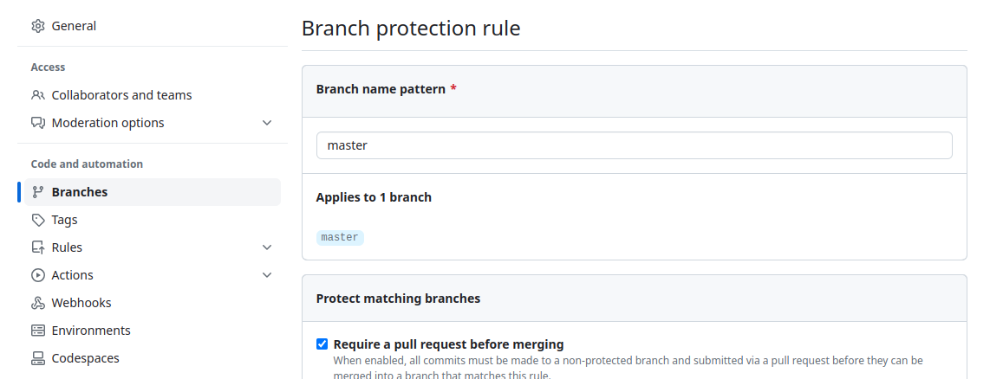
Useful things to note
I usually lock main branch on collaborative repos to avoid accidental pushes

Slide 18
Maintaining a clean git
Prevention is much easier than tidying up later

Slide 19
Not everything belongs in git
Large files (so hard to remove once committed!)
Passwords
Outputs (sometimes)
Use .gitignore (helpful templates at https://github.com/github/gitignore)
Tools will often automatically update your .gitignore

Slide 20
Removing accidentally pushed file
Deleting it and committing the deletion is not enough
You'll probably have to force push
https://stackoverflow.com/questions/43762338/how-to-remove-file-from-git-history

Slide 21
Stashing to save for later
git stash - to stash current changes
git stash pop - to pop changes off stash
git stash list - to see what you have stashed
Stash is not per branch, so I'd be careful using these for anything longer than a quick temporary switch
git stash –-all

Slide 22
Reverting and not ruining everything
Commit amend
Reverting a commit
Git reset

Slide 23
Committed an update and immediately realise I need to make one small change
If you've not pushed it yet – very easy
Make the change
`git add .`
`git commit --amend` (or `git commit --amend --no-edit)
If you have commited you need to be more careful, but you do the above and then `git push --force-with-lease`

Slide 24
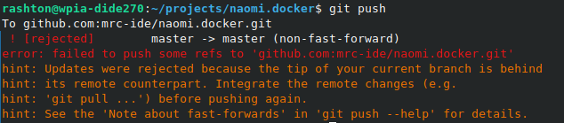
Force pushing
If you try to push to revert an issue you might see an error like
You'll have to force push to overwrite the remote
`git push --force` will replace the remote with your working copy
`git push --force-with-lease` will replace the remote with your working copy only if no more commits have been added to the remote branch

Slide 25
Git revert
You can revert an individual commit
Find the hash of the commit
`git revert <hash>` - this creates a new commit that undoes that commit so can be a little ugly!

Slide 26
Accidentally committed to main
Easier if you haven't pushed yet
`git branch new-branch` - create a new branch for your change
`git reset HEAD~1 --hard` - remove the last commit from the master branch
If you have pushed
Push after creating your new branch
Do the reset, then force push with lease

Slide 27
Accidentally committing to wrong branch
`git reset HEAD~1 --soft` - undo the last commit but leave the changes available
`git stash`
`git checkout correct-branch`
`git stash pop`
`git add .`
`git commit --m "message here"`

Slide 28
Resources
Pro Git - Best book on Git, helped me learn! (Don't have to read it all right away)
Happy Git with R - git guide for data scientists from R
Atlassian git tutorials - well explained overviews of git commands and concepts
Oh Shit, Git - help to fix a screwed up git

